Slide 1
TIP ESTIMATION
This project aims to explore the factors that influence tipping behavior in taxi trips, leveraging the rich data available in the Yellow Taxi Data Set for 2022. By analyzing the relationships between fare amounts, payment methods, and tip amounts, the team seeks to uncover valuable insights that can benefit taxi drivers, companies, passengers, and regulatory authorities.
Group 2
RAMYA ALLURI
GOWTHAMI PAKANATI
SARAN KUMAR SALLAGUNDLA

Slide 2
Problem Statement
1 . Research Question: How do fare amounts and payment methods affect the tipping behavior of taxi passengers?
2. Potential Benefits: The data-driven insights from this analysis can help taxi drivers maximize their earnings, taxi companies design better incentive programs, passengers receive improved service, and regulatory authorities make informed policy decisions regarding fair compensation practices.

Slide 3
Overview of the Dataset
Data Source :
The primary data source for this project is the Yellow Taxi Data Set for 2022, which provides a comprehensive record of taxi trips in New York City.
Key Features:
The dataset includes essential information such as vendor ID, pickup and drop off times, passenger count, trip distance, fare-related details (rate code, fare amount, extras, taxes, tolls, surcharges), payment information (payment type, tip amount, total amount), and additional features like location IDs, congestion surcharge, and airport fees.
Data Size:
The original dataset contains 39.7 million rows and 19 columns. For this analysis, a subset of 250,000 rows was used to ensure efficient processing and meaningful insights.

Slide 4
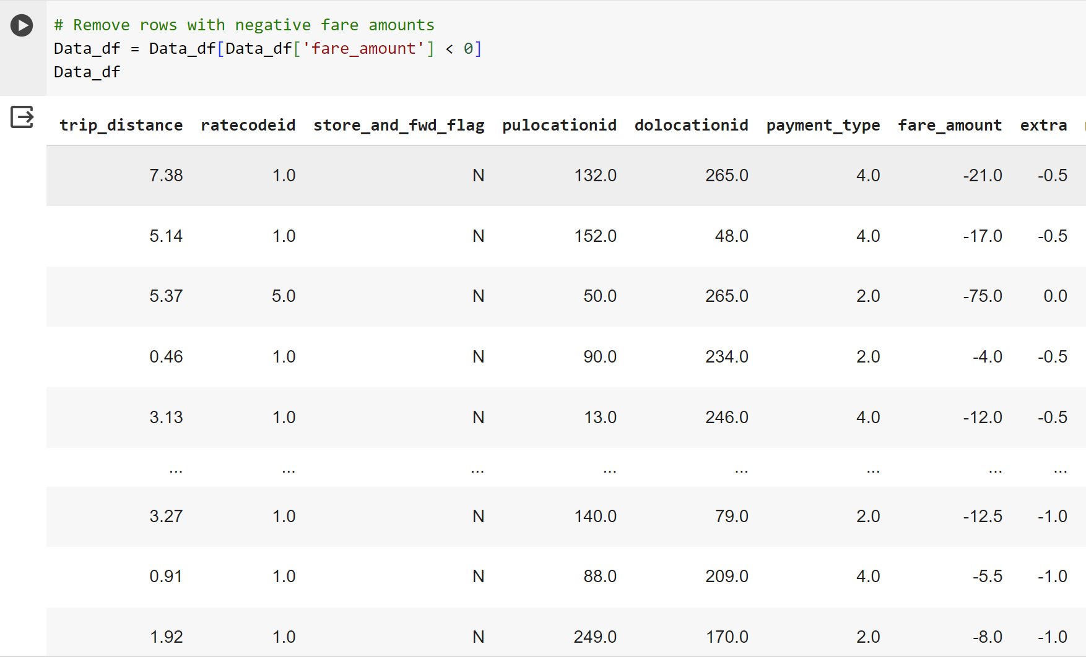
Data Preparation and Cleaning
The data cleaning process involves handling missing values, addressing outliers, and removing negative fare amounts. Various data transformations and conversions were performed to ensure the data was in a suitable format for analysis.

Slide 5

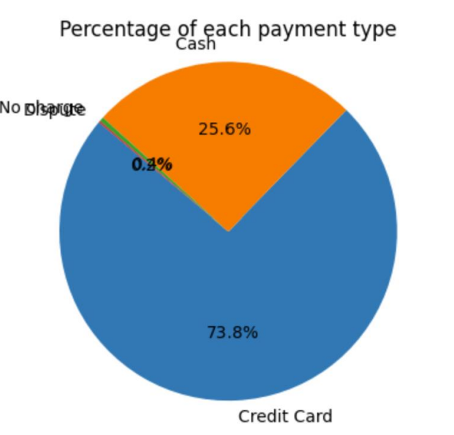
Statistical Analysis
Payment Type Analysis:
Here we have evaluated the proportion of passengers that are present within each type of payment type category and also evaluated the proportion of individuals within each payment type category who provide a tip.
Here payment type value suggest
1= Credit card
2= Cash
3= No charge
4= Dispute

Slide 6
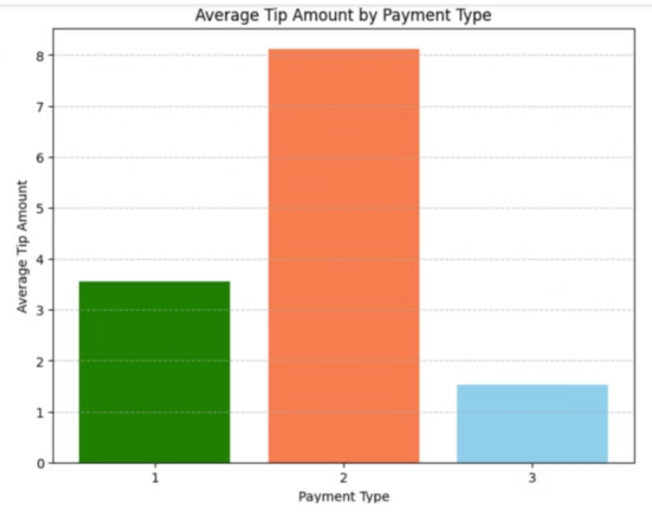
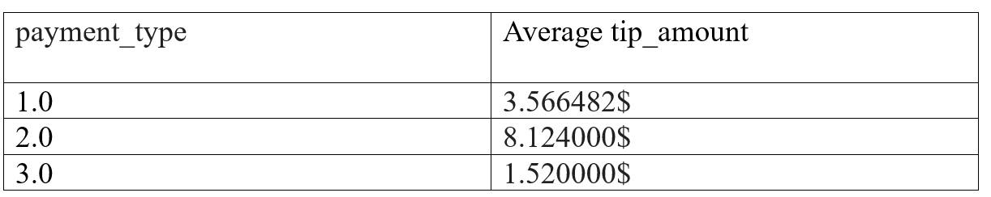
Finally, we have calculated the average tip amount provided by passengers from each payment type category.
Apart from this, we have observed that people who provide tips were 99 percent from category 1 i.e, card-type payment

Slide 7
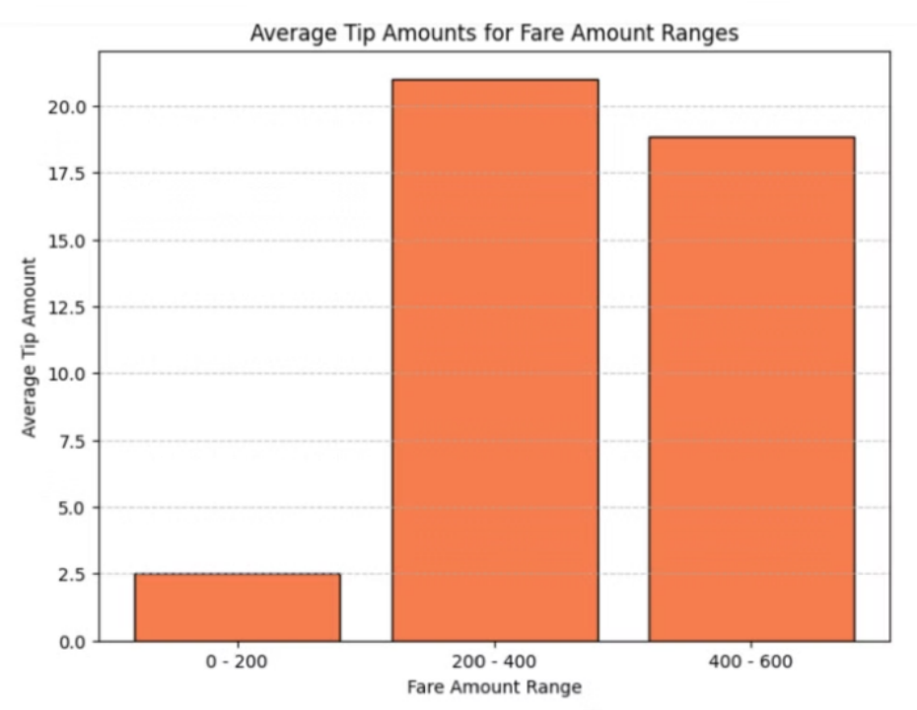
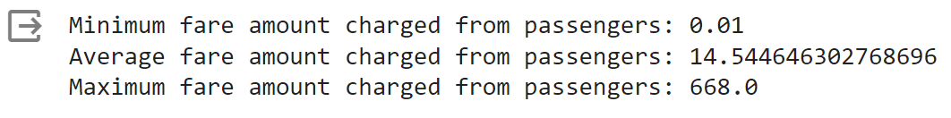
Fare amount analysis The minimum, average, and maximum fare amounts were calculated and presented. The data was further divided into different fare ranges, and the average tip amounts within each range were analyzed and visualized using appropriate charts and plots.
Fare Amount Analysis

Slide 8
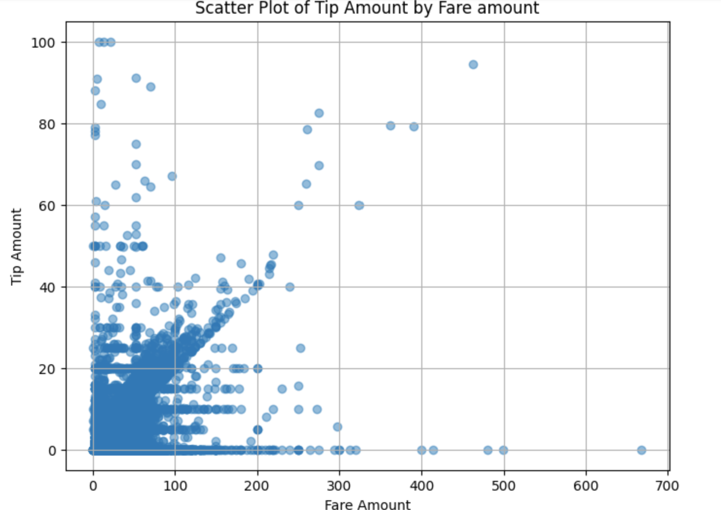
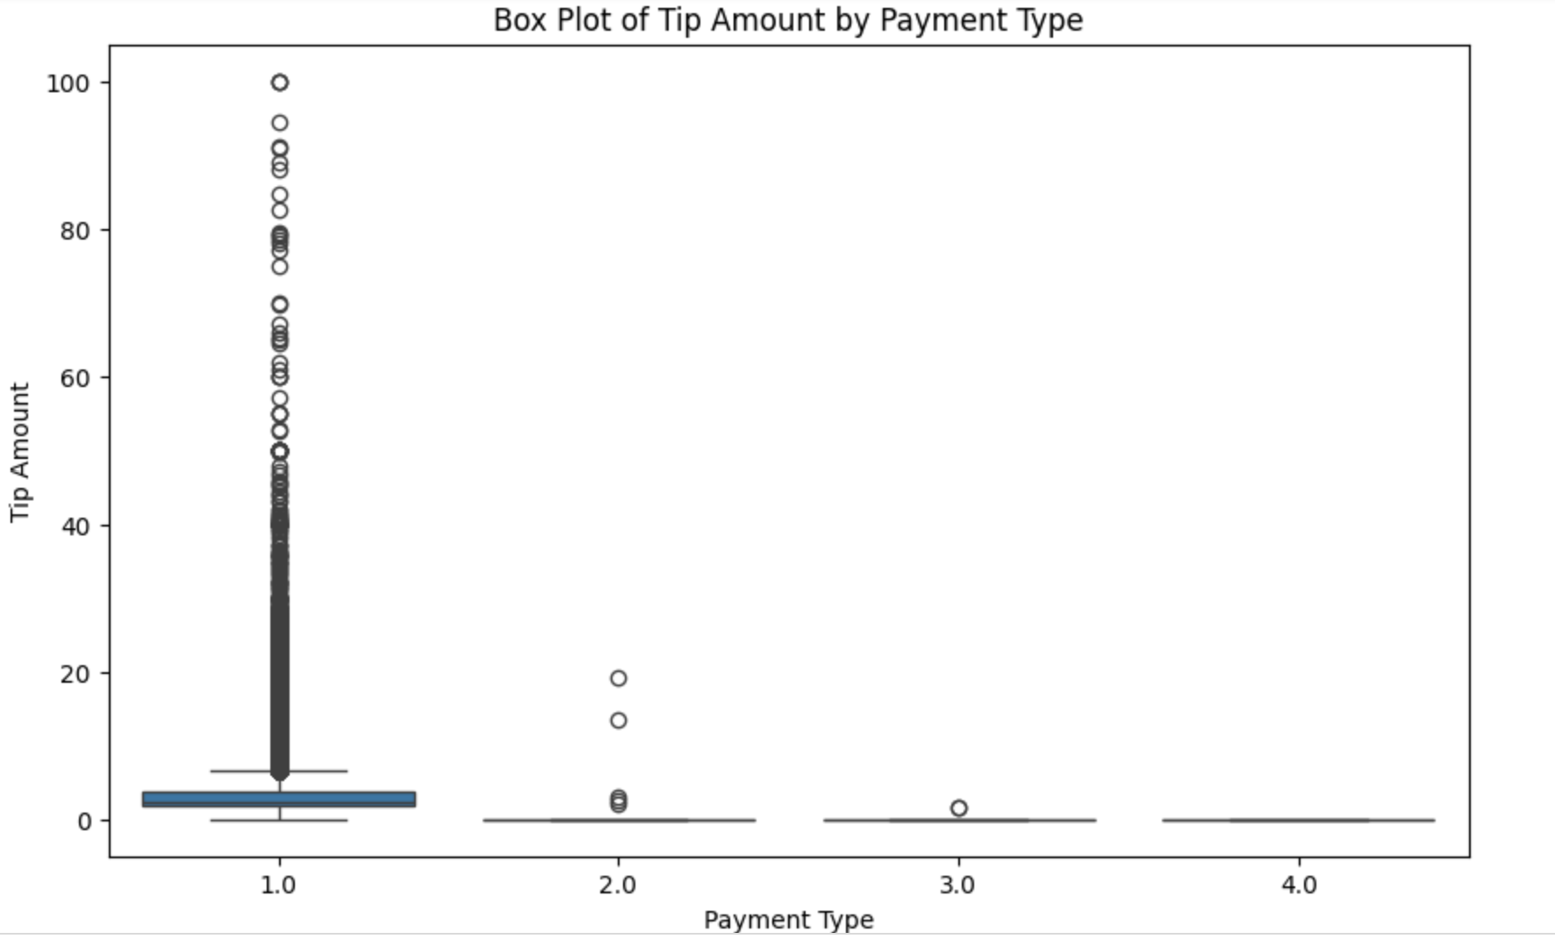
Data Visualization
Here we have visualized the above analysis by plotting a scatter plot between the tip amount and the fare amount of a trip. Also, we have plotted a box plot between tip amount and payment type

Slide 9
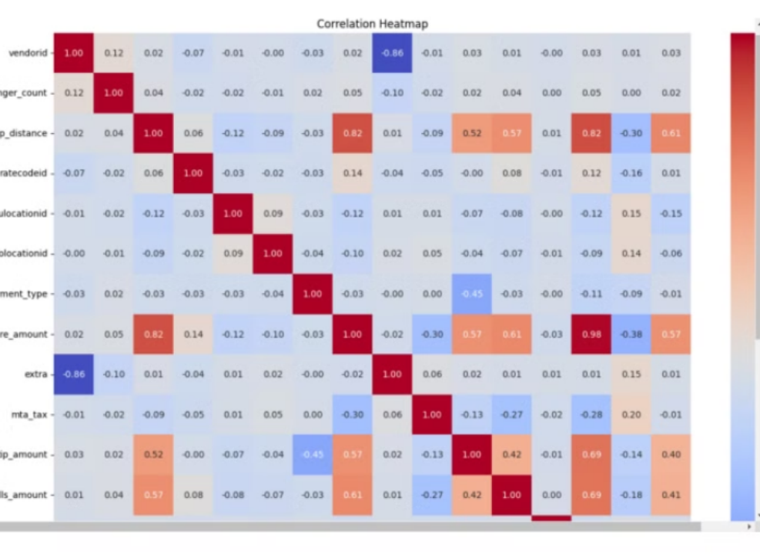
Correlation Analysis
A correlation heatmap was generated to visualize the relationships between the selected predictors (fare amount, payment type) and the response variable (tip amount).
The values of correlation coefficients were used for the selection of predictor variables.

Slide 10
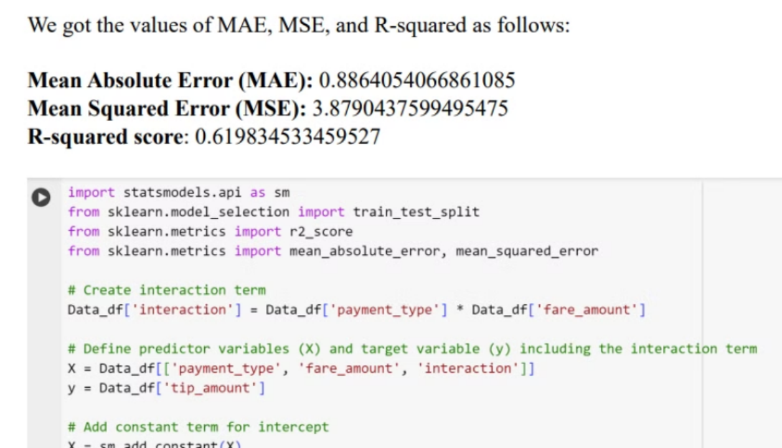
Modeling
Initial Modeling
Linear Regression:
First, we have started with a linear regression model to predict tip amounts based on the selected predictors. The data was split into training and testing sets, and the model's performance was evaluated on both sets.

Slide 11
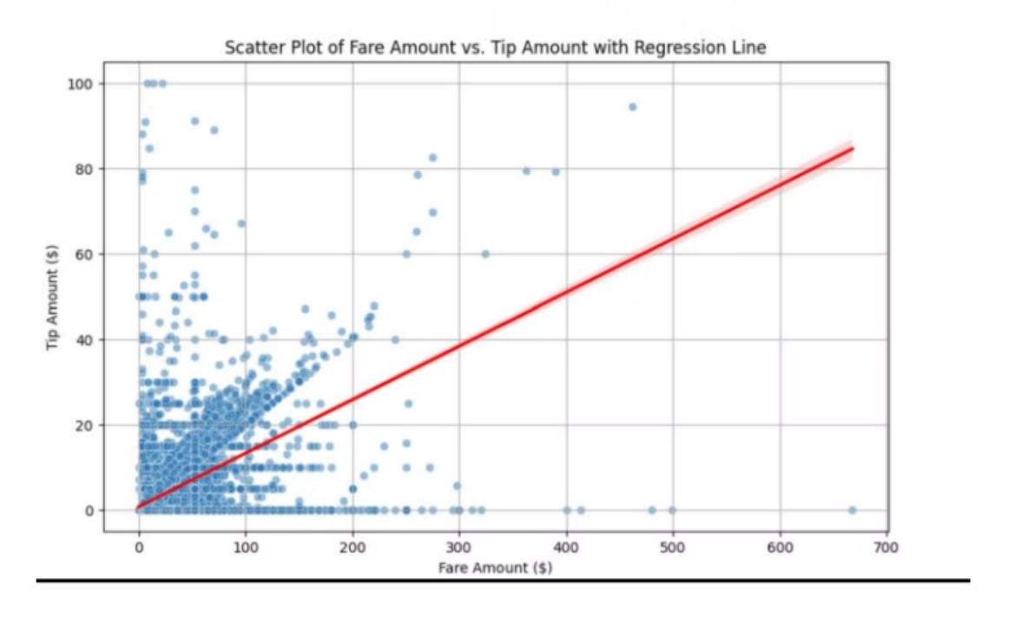
Fitted plot between predictor and response variable:
fare_amount vs tip_amount :

Slide 12
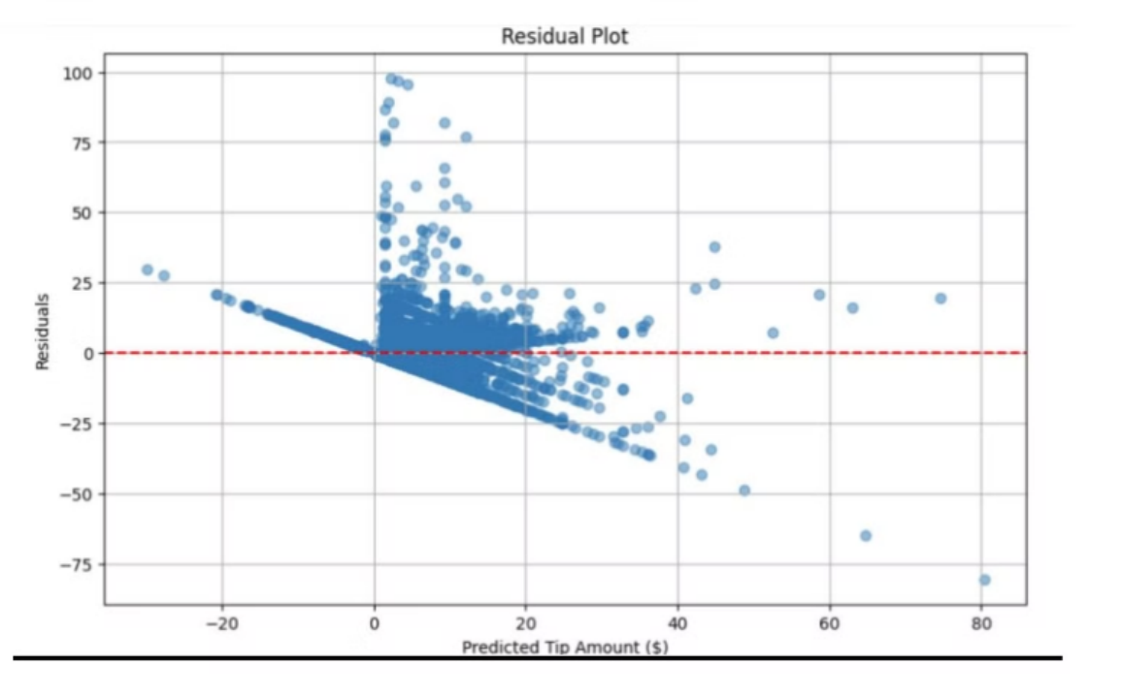
Residual Plot:
As we can observe our fitted model contains most of the residuals evenly distributed around the horizontal line at y=0, which indicates that the model adequately captures the variation in the data

Slide 13
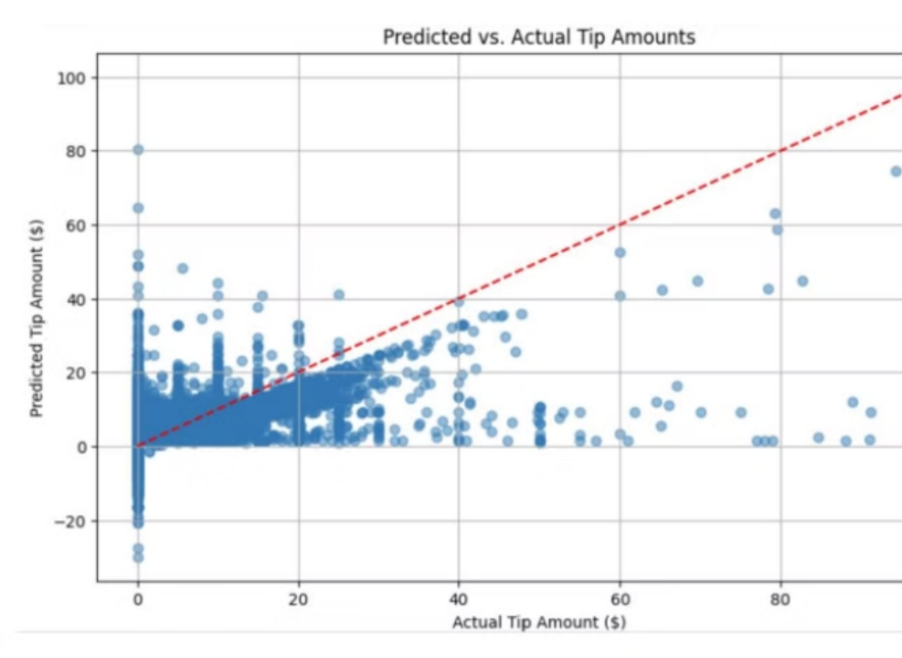
Actual Vs Predicted Plot:
Our fitted model has points that closely follow the diagonal line (y = x), indicating that the model's predictions closely match the actual values.
Also, some values are deviated from this diagonal line suggesting that there are some discrepancies between the predicted and actual tip amounts.

Slide 14
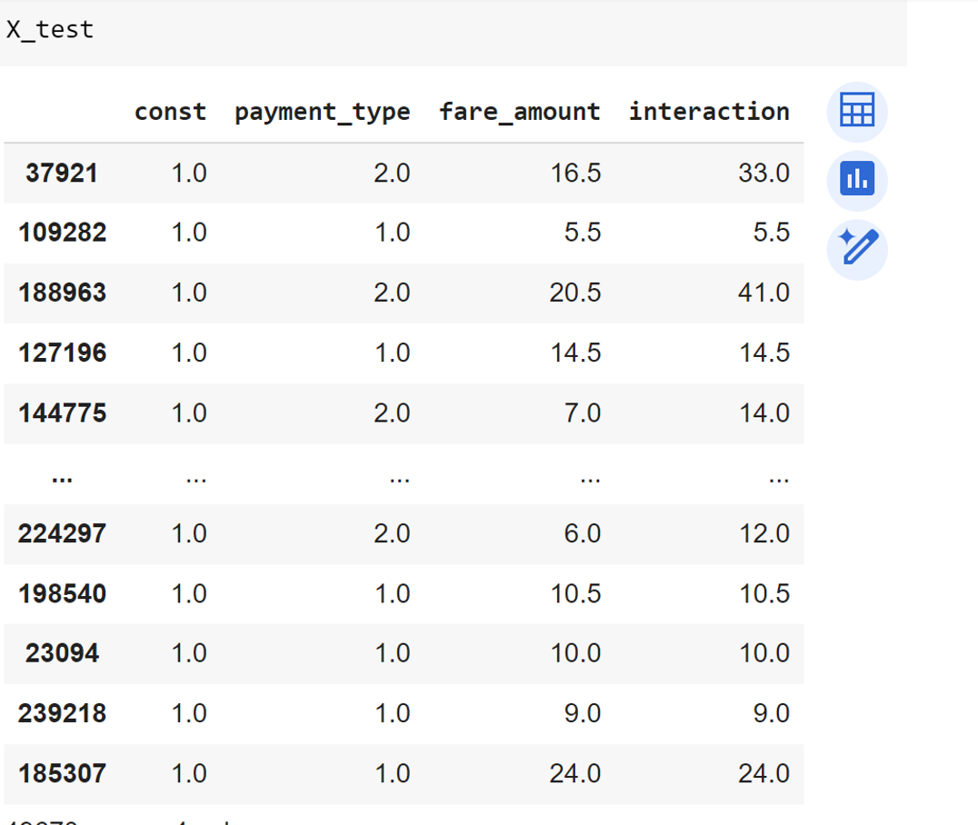
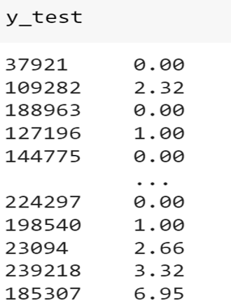
Predicting with new data:
Using the model to predict tip amounts in test data.
Here is the 20% actual test data set that we have considered
Here we have taken the values from the test data set as payment type:1.0, fare_amount: 10, and predicted tip_amount as 2.58$. The actual value for this row values in the test data is 2.66$

Slide 15
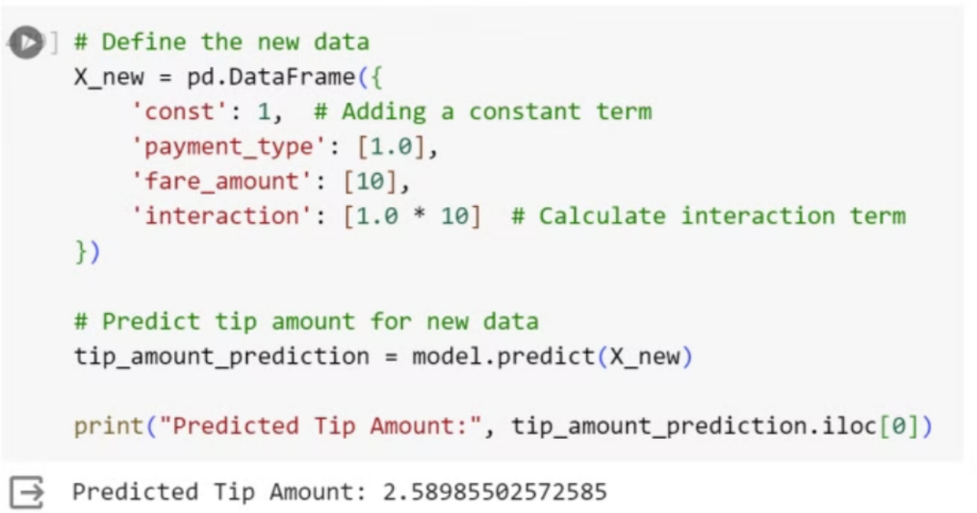
Results of initial modeling:
Overall, while the initial modeling effort provided valuable insights into the relationship between independent variables and tip amounts, there is potential for improvement to achieve more accurate predictions.
Further iterations of modeling and analysis may lead to a comprehensive understanding of tipping behavior in taxi rides and improve the model's predictive performance

Slide 16
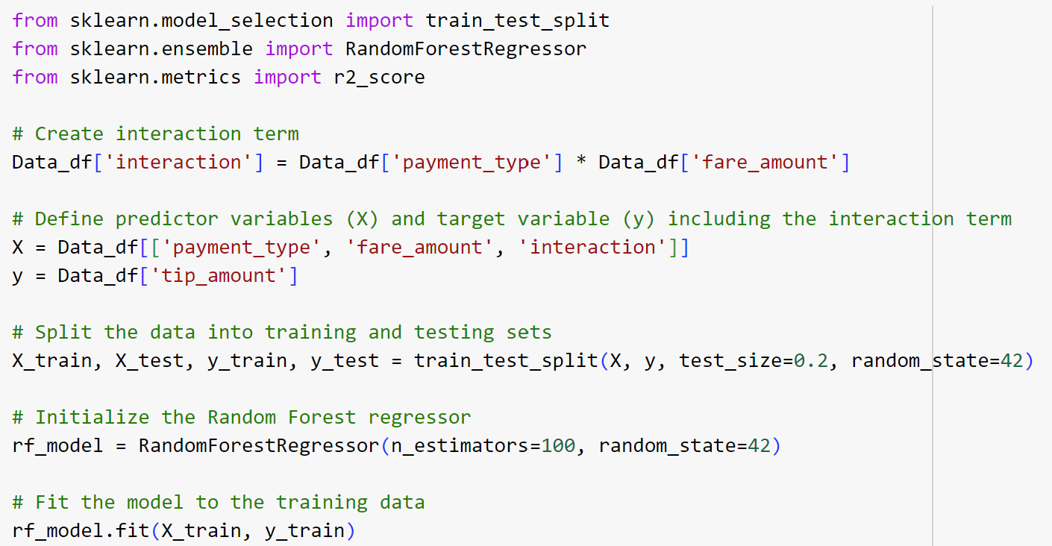
Final Modeling:
Random Forest model has been used to predict the tip_amount based on the predictors fare_amount and payment_type.
Mean Absolute Error (MAE): 0.7489314102756794
Mean Squared Error (MSE): 3.4001489718891986
R-squared score: 0.6667685903542941

Slide 17
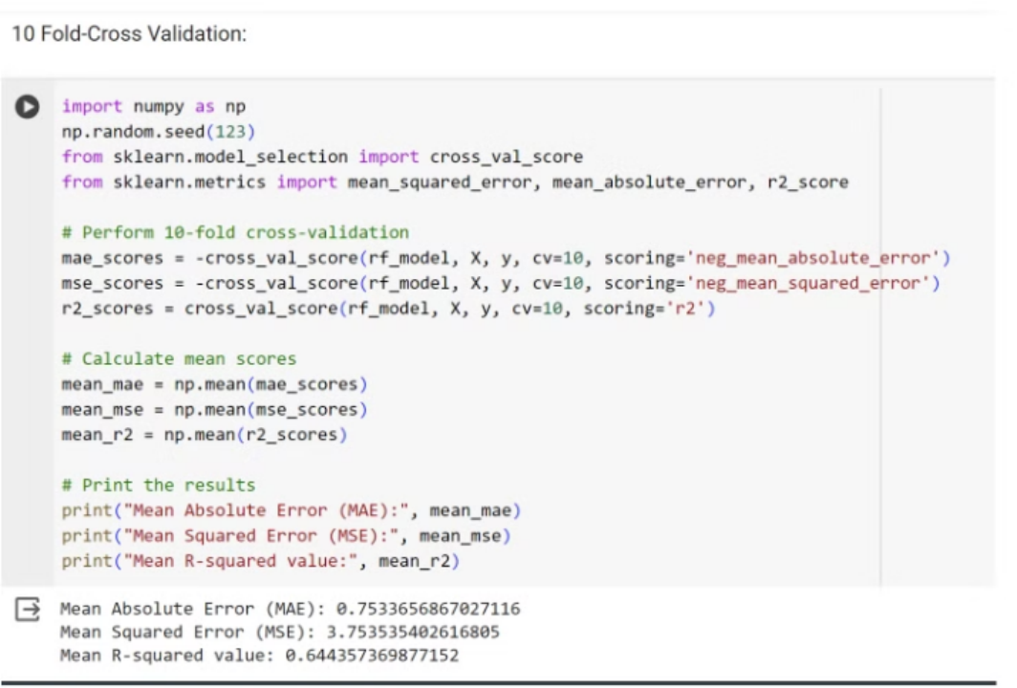
Checking Model Quality
Cross Validation:
10-fold Cross-validation is used here to evaluate the performance of a Random Forest regression model. Instead of just splitting the data into training and testing sets once, it splits the data into 10 different subsets, or folds. Then, it trains the model on 9 folds and evaluates it on the remaining fold, repeating this process 10 times, each time with a different fold held out for testing.
Metrics:
Overall, the resultant values of MAE: 0.7533, MSE:3.7535 and R-squared value: 0.644 after performing 10-fold cross-validation are similar to the random forest model performed one fold suggesting that the model performance is good and we can predict tip amounts based on the predictors behavior

Slide 18
Performance Evaluations
Future Improvements
To enhance the model's accuracy, the team suggested exploring alternative modeling techniques, such as polynomial regression, decision trees, ensemble methods, and neural networks. Iterative modeling and continuous improvement were emphasized as crucial steps in the process.
Ongoing Refinement
The team recognized the importance of continuously refining the model, incorporating additional features, and exploring more advanced algorithms to achieve better predictive insights and address the research question more effectively.

Slide 19
Insights and Conclusions
Key Findings
The analysis revealed significant relationships between fare amounts, payment types, and tip amounts. Patterns emerged, such as the influence of payment methods on tipping behavior and the varying tip amounts across different fare ranges.
Potential Applications
The findings and predictive model can create value for various stakeholders, including taxi drivers (optimizing earnings and providing better service), taxi companies (guiding driver incentives and service design), passengers (improved service and transparency), and regulatory authorities (informing fair compensation practices).
Future Work
We identified opportunities for future work, such as enhancing model accuracy through additional feature engineering, incorporating external data sources, and exploring other factors that may influence tipping behavior (e.g., trip duration, driver behavior).

